Slide 1
Subject: Electricity Laboratory
Experiement 5: Calculating the value of unknown resistor
Al-Karkh University of Science
College of Science
Department of Medical Physics
Prepared by:
Dr. Nihad K Ali
Zaineb Faleh Nazal

Slide 2
Calculating the value of unknown resistor
Objective of the experiment:
Finding the value of unknown resistor using known resistor.
Examine the effect of the resistance value on the electrical current in the circuit.
Learn how the galvanometer work.

Slide 3
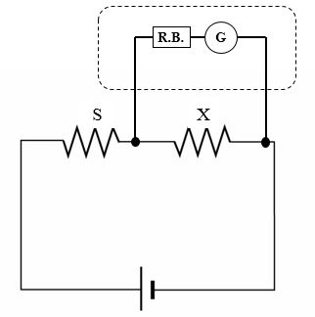
Theory:
If we have the electrical circuit shown below:

Slide 4
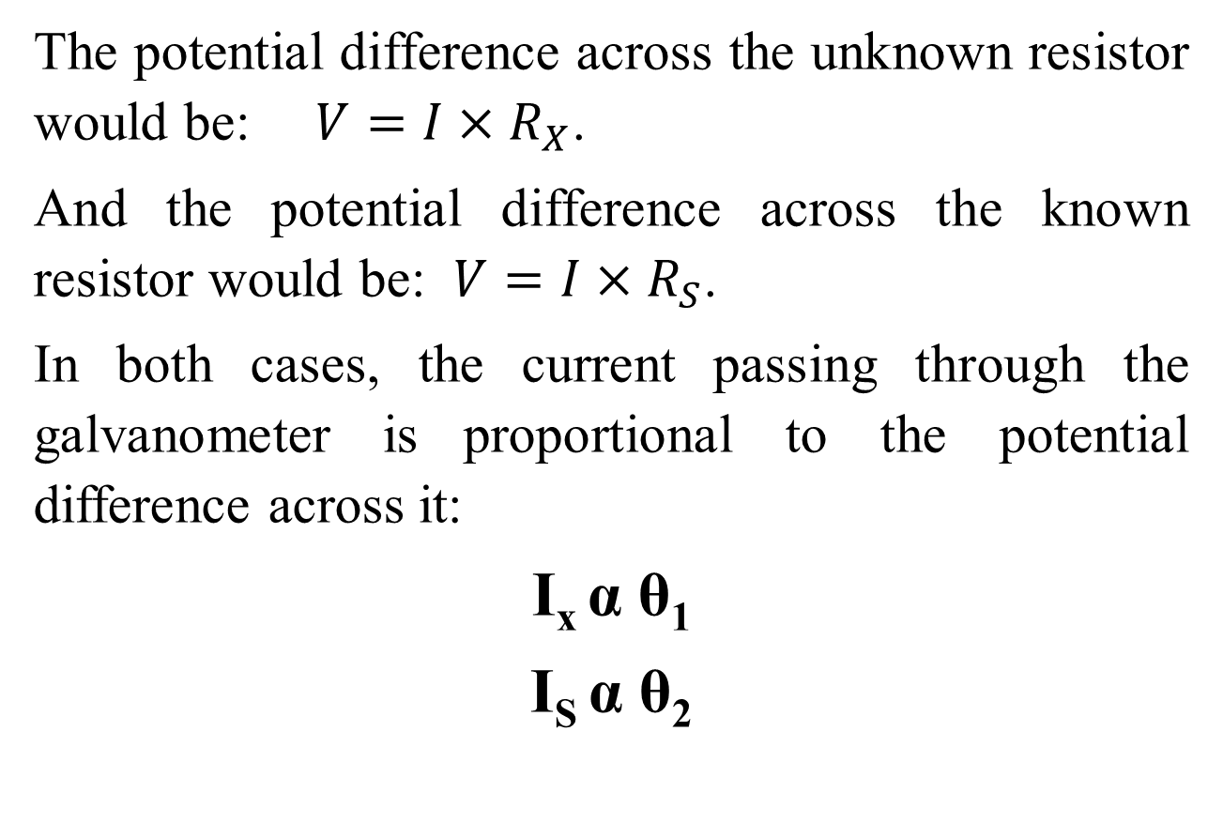
The potential difference across the unknown resistor would be: $V=I×R_{X}$.
And the potential difference across the known resistor would be: $V=I×R_{S}$.
In both cases, the current passing through the galvanometer is proportional to the potential difference across it:
I_{x} α θ₁
I_{S} α θ₂

Slide 5
Instruments:
DC power supply.
Galvanometer.
Resistor box R.B.
Unknown resistor R_{X}.
Known fixed resistor R_{S}.
Connection wires.

Slide 6
Methods:
Connect the circuit as shown in Figure 1.
Connect high resistance from resistor box in series with galvanometer to avoid the current effect passing through galvanometer.
Set the voltage form DC power supply at 10 volts.
Record the galvanometer reading θ₁ (the galvanometer and resistor box in parallel with X).
Transfer the galvanometer and resistor box to be in parallel with S and record the galvanometer reading θ₂.
Change the resistance form resistor box and record θ₁ and θ₂.
Repeat the previous step several times and record θ₁ and θ₂ for each resistance form resistor box.
Write down your reading in the table below:

